Slide 1
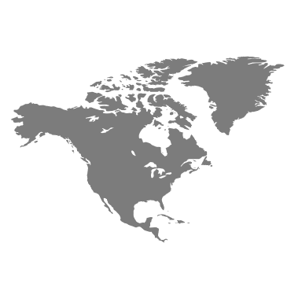
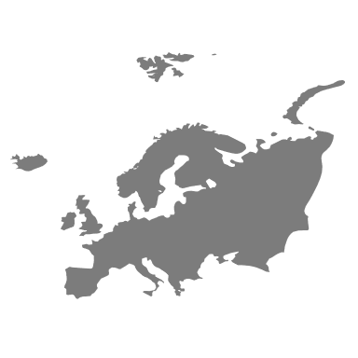
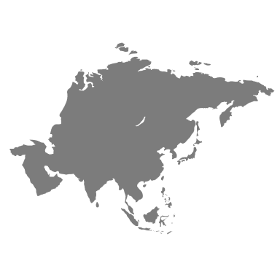
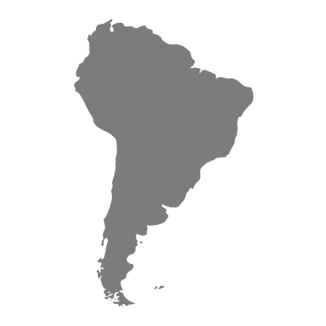
Israel
United
States
Palestine
Colombia

Slide 2
 |  | Israel
 |  | Not Break ties | Break ties
Colombia | Not Break ties | 1, 1 | 0, -1
 | Break ties | -1, 0 | -1, -1

